Slide 1



A place to find, add or review gifts for loved ones
PresentDAO

Slide 2
WHAT IT DOES?
It allows users to add gifts they have recently given or received from someone.
It allows users to search for gifts given the specifications of the receiver.
It allows for a review and rating system to generate proper feedback.
Essentially makes the whole process of thinking of gifts before birthdays easier and peer-connected.

Slide 3
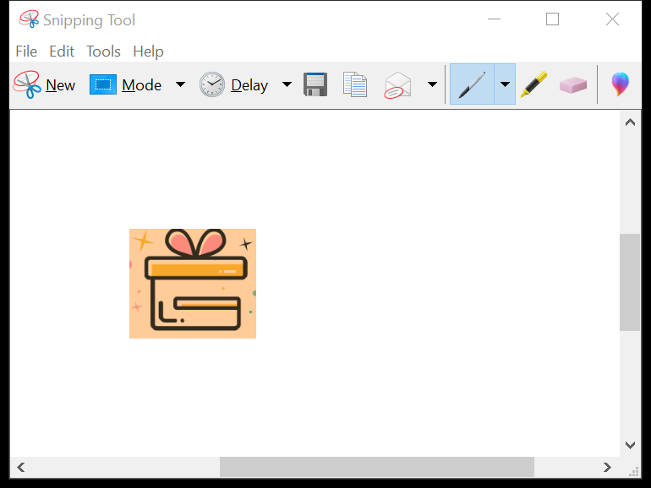
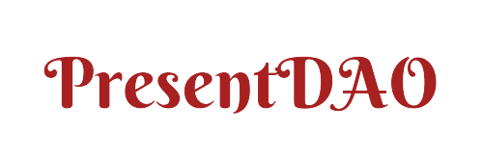
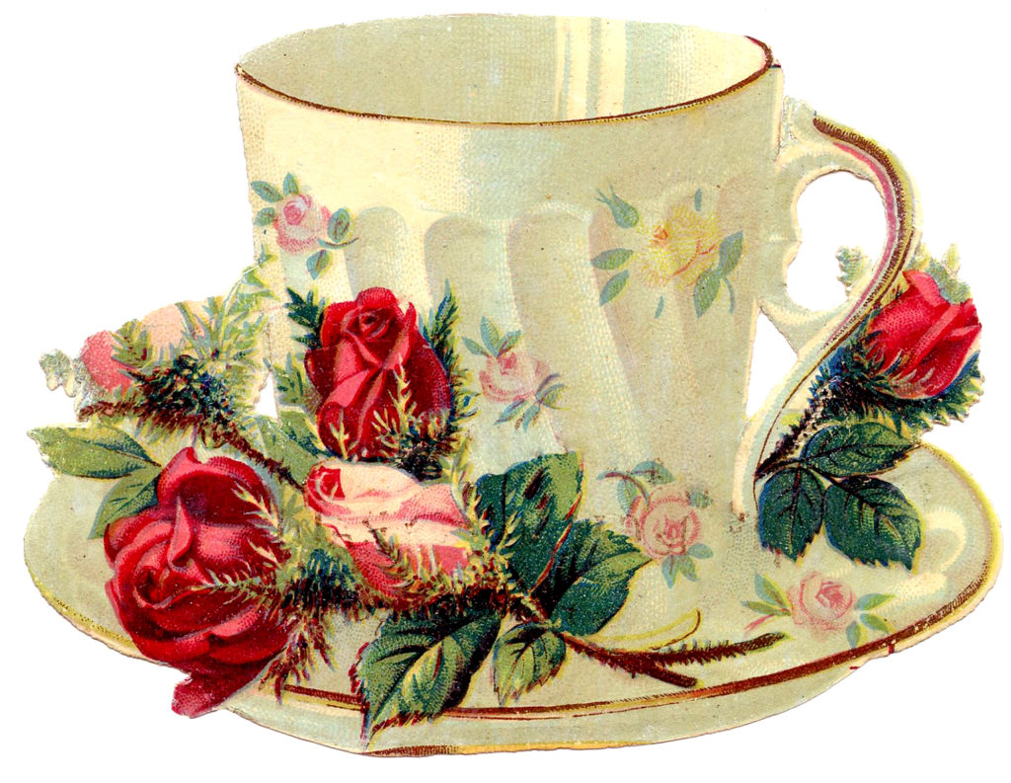
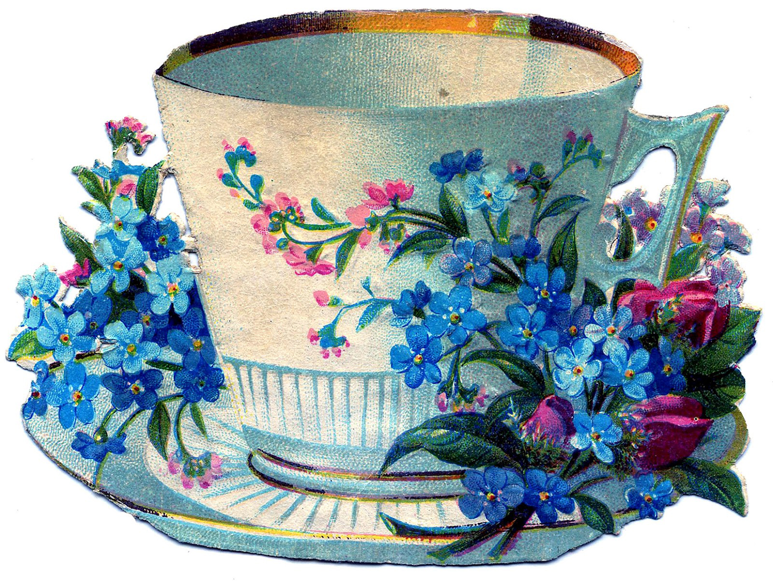
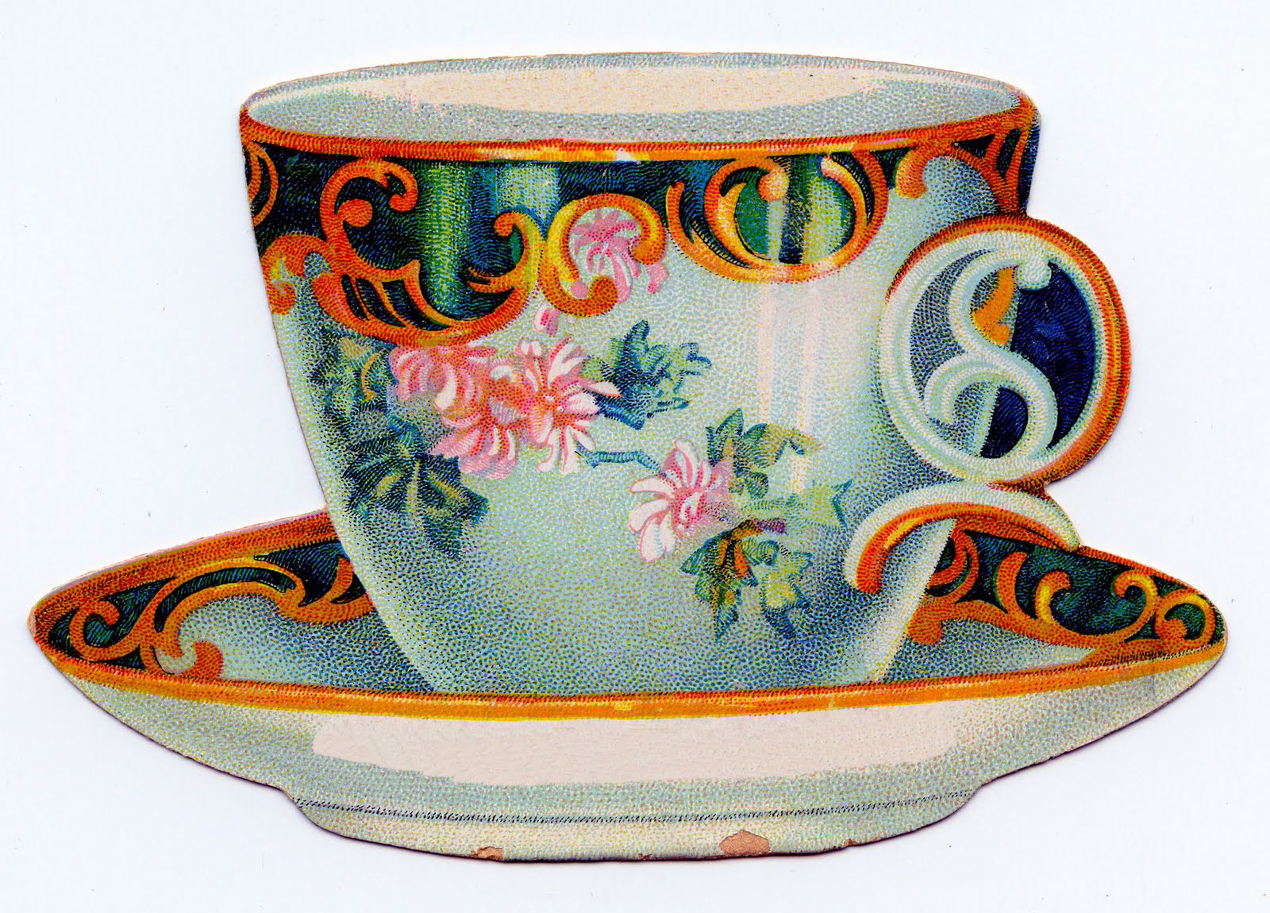
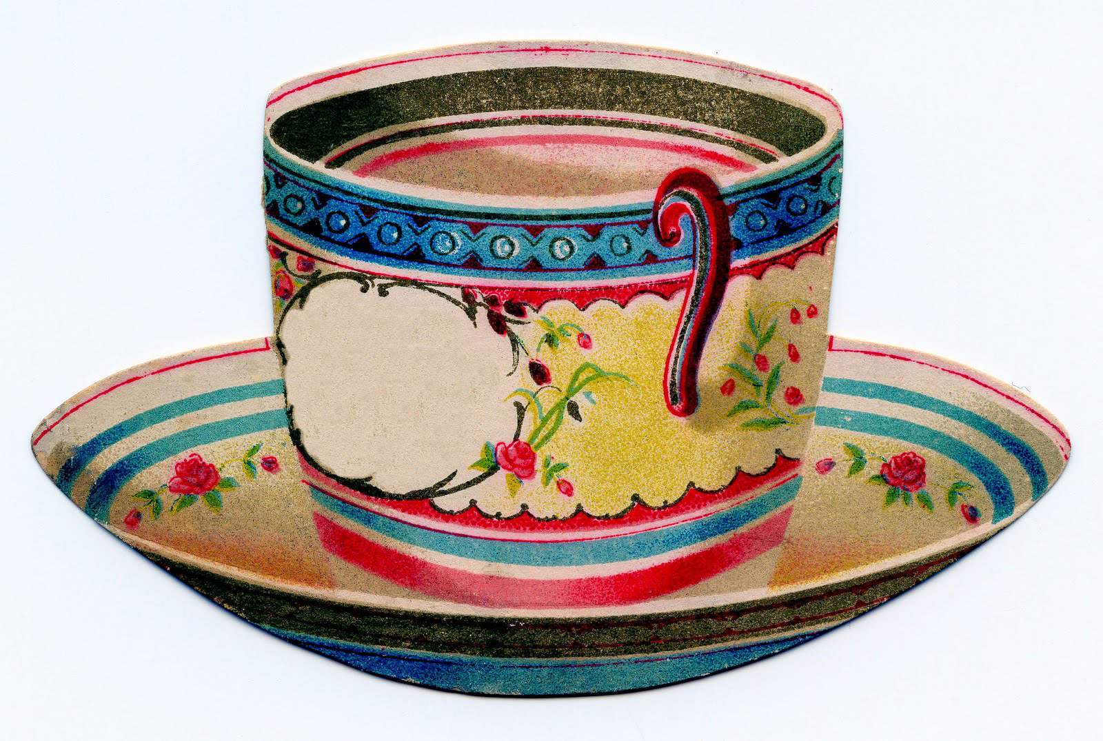
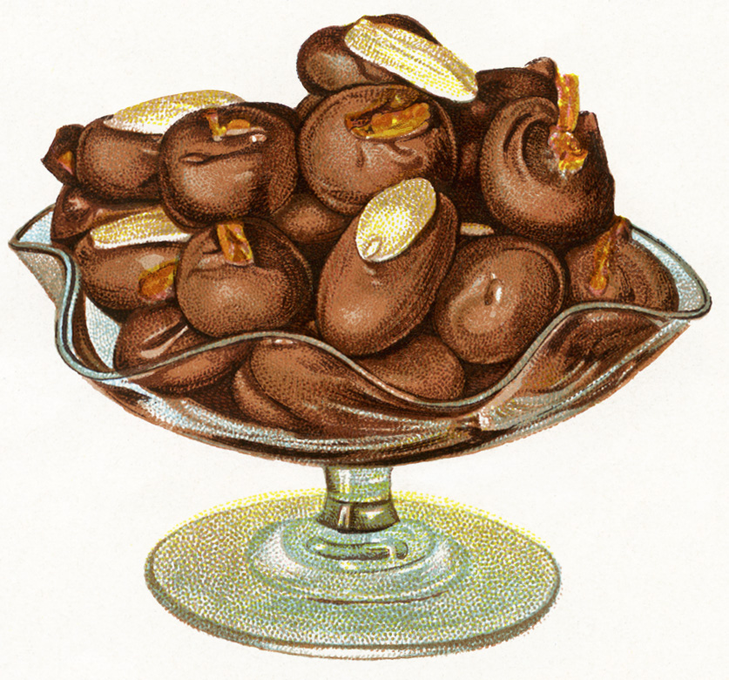
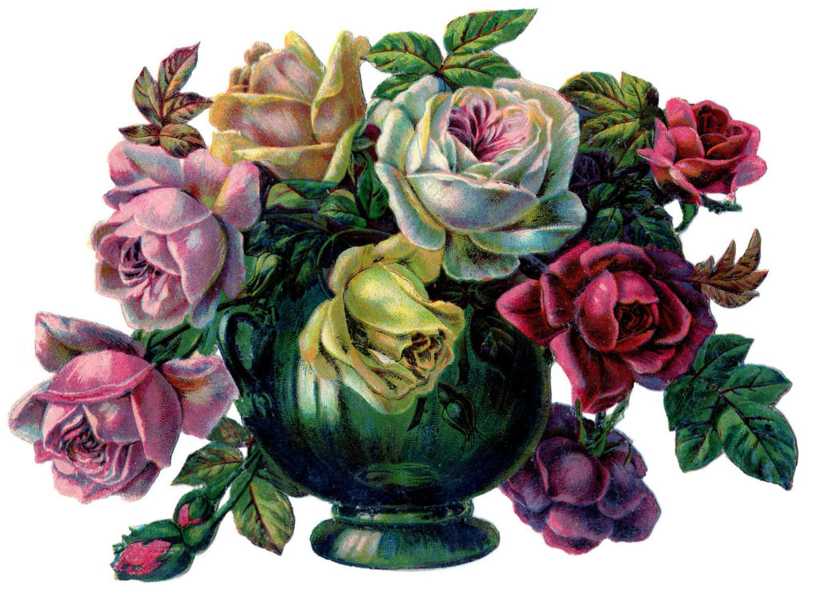
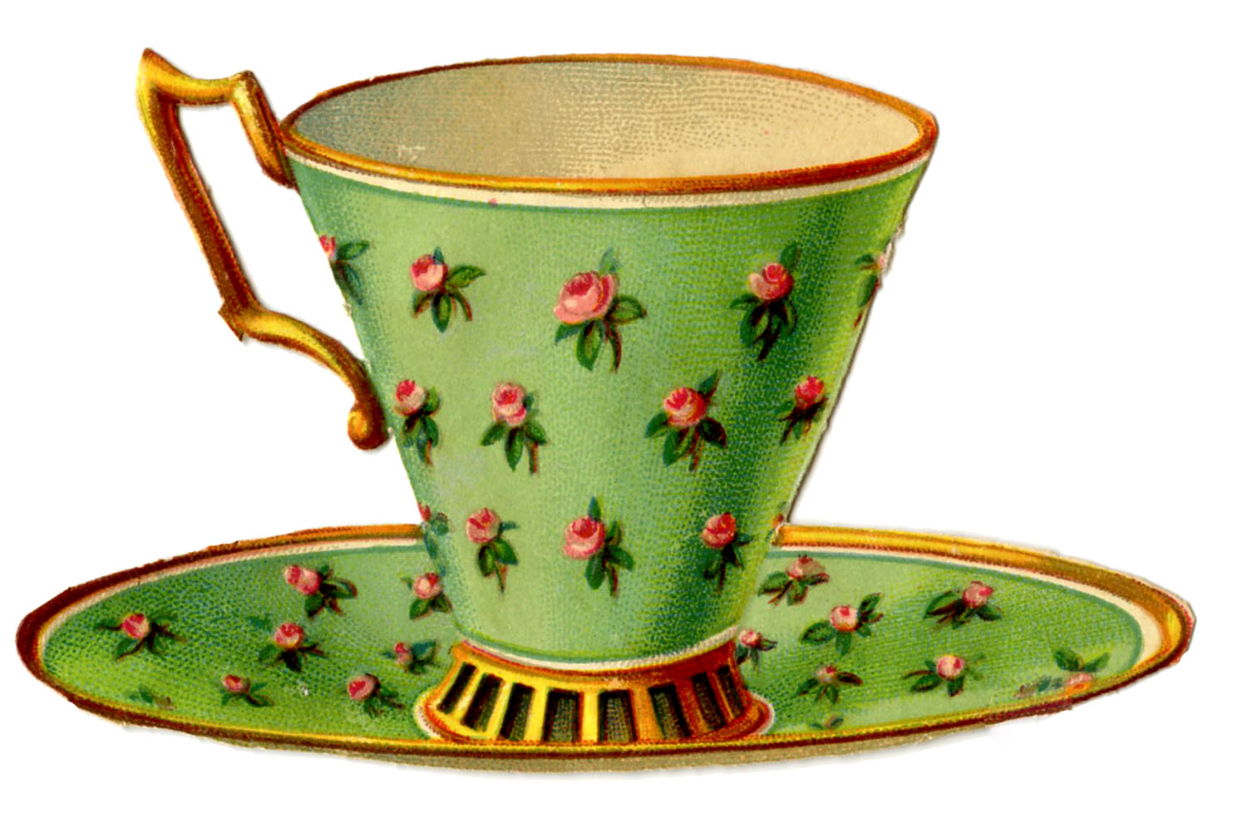
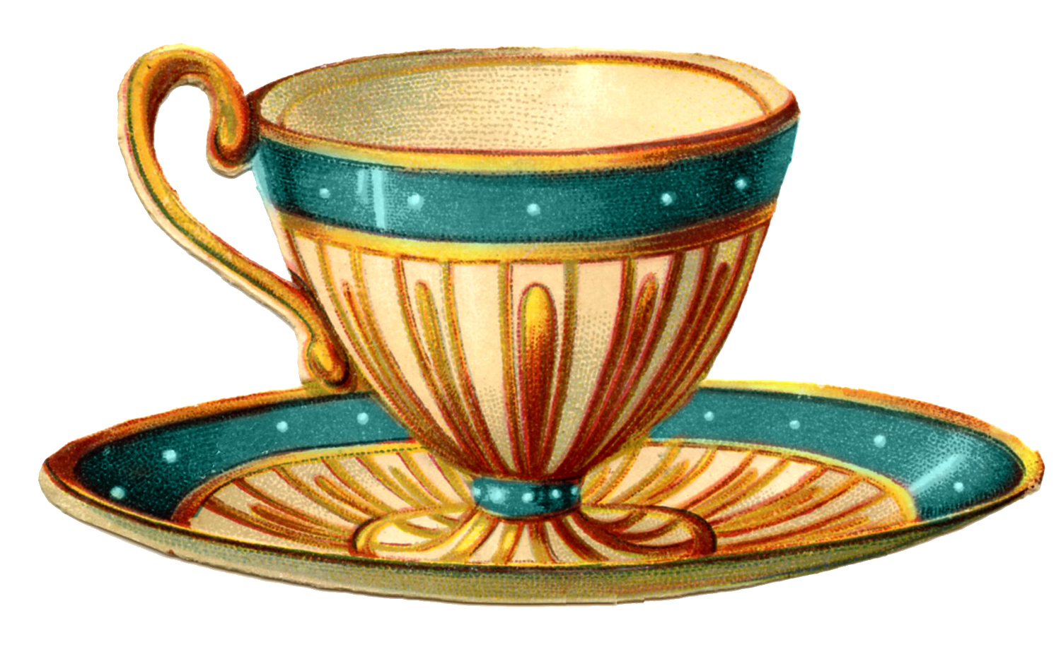
PROFILE
ADD PRESENT
search
age
category
gender
price
rating
submit
Chocolate Cup $20
13, M 4.9⭐
Tea Cup - Blue $14
22, F 4.5⭐
Vintage Cup $15
32, N 4.3⭐
Kid’s cup $18
14, F 3.9⭐
Chocolate $10
15, N 4.4⭐
Flower Vase $50
43, M 4.9⭐
Green Tea Cup $10
27, F 4.6⭐
Fantasy Tea Cup $15
35, F 4.9⭐
Notes:
(#F9B872, #FAE7A5): Orange
powder blue (#B6E1E7)

Slide 4
PROFILE
ADD PRESENT
Category: Household
Hot Chocolate Cup
$20
Pretty white ceramic cup. I gifted it to my 13-yr old nephew and he was delighted. Beautiful and sturdy.
REVIEWS:
Gift Specifications
Age: 13
Gender: Male
Rating: 4.9
0xeknn39dns……
Great Gift. I got it for my daughter. It’s sturdier than it looks.
GO TO ITEM LINK 🔗
Notes:
(#F9B872, #FAE7A5): Orange
powder blue (#B6E1E7)

Slide 5
PROFILE
NAME:
DESC:
IMAGE:
LINK:
CATEGORY:
AGE:
PRICE:
GENDER:
SUMBIT
Notes:
(#F9B872, #FAE7A5): Orange
powder blue (#B6E1E7)

Slide 6
PROFILE
ADD PRESENT
GIFTS YOU HAVE ADDED
Chocolate Cup $20
Tea Cup - Blue $14
Vintage Cup $15
Kid’s cup $18
GIFTS YOU HAVE REVIWED
Chocolate $10
Flower Vase $50
Green Tea Cup $10
Fantasy Tea Cup $15
Notes:
(#F9B872, #FAE7A5): Orange
powder blue (#B6E1E7)

Slide 7
THE FUTURE OF PRESENTDAO
Add extensive yet user-friendly filtering systems.
Use IPFS for the upload of images and metadata
Use NFTs to store the gift and reviewer data and upload it to IPFS
Improve the UI
Include a way for small business owners to sell gift products
Essentially makes the whole process of thinking of gifts before birthdays easier and peer-connected.

Slide 8
THANKS A LOT FOR YOUR TIME AND ATTENTION
THANK YOU

